Slide 1
Home Service
A web Portal to facilitate the communication between users and home service providers

Slide 2
Introduction
With increased working population globally, there have been an increased necessity to bridge their need of home services like plumbing, electricity, minor civil tasks – which are typically an unorganized sector. A one-stop portal for all domestic services is the need of the public wherein a user is able to perform a location based search, by service, by price quoted by the service provider.

Slide 3
What we developed ?
A maven project which contains various webpages that support the functionality we want in our application.
Spring mvc framework is used as a middleware to facilitate the interaction between webpages and database.

Slide 4
What our project does ?
In our application, we have three types of user’s, that is, Admin, Worker and Customer. Customer is referred as “User” in our application.
Worker need to register via worker registration page. And can provide his/her services.
User can view the services and workers available at a given location and can made request for the available services.

Slide 5
Continue…
We have used Google Map API to implement location based search.
Admin is responsible for assigning the worker to a given user’s request.
Currently, the application is developed for three services that is, mechanic, plumber and electrician. Admin can add/remove more services.

Slide 6
Technology Used
Front End: HTML 5, CSS4, Bootstrap.
Middleware: Spring MVC, Google map API
Backend: MYSQL Workbench

Slide 7
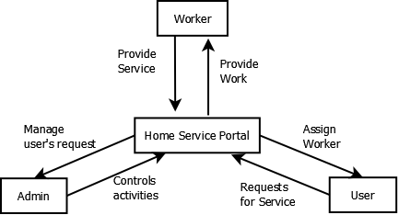
DATA FLOW DIAGRAM

Slide 8
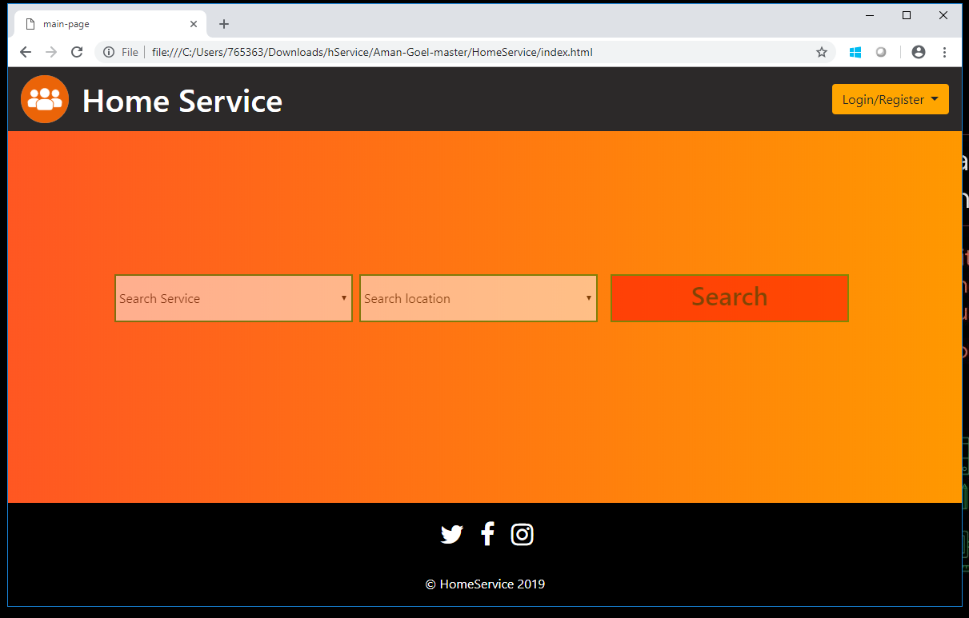
Home-Page

Slide 9
Continue…
Now we would like to start with the demo…

Slide 10
Thank You

